Slide 1


Slide 2
What is CloudHour?
Objective of CloudHour
Round-table discussion
Focus on a few key topics
Why It's Important
Rapid changes in cloud security and tech
Stay updated and connected for growth as community
How it will benefit the community
Real-time engagement with hosts and community members
Ask open questions and speak your opinion
Opportunity to affect the next agenda
Notes:
Objective of CloudHour
The objective of CloudHour is to create a collaborative space where professionals can come together to discuss, learn, and share insights on the most pressing topics in cloud security and modern workplace technology.
Why its important
CloudHour is important because, in the rapidly evolving landscape of cloud security and workplace technologies, staying updated and connected is crucial for career growth and organizational resilience
How it will benefit the community
By attending CloudHour, community members will have the unique opportunity to engage with industry experts in real-time, ask questions, network with like-minded professionals, and even have the chance to contribute their own expertise by becoming guest speakers in future episodes.

Slide 3

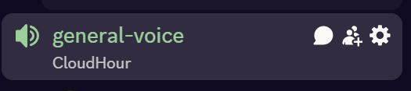
If you prefer to not talk or be asked questions press mute
Open Mic is allowed
Remember to open the chat

Slide 4
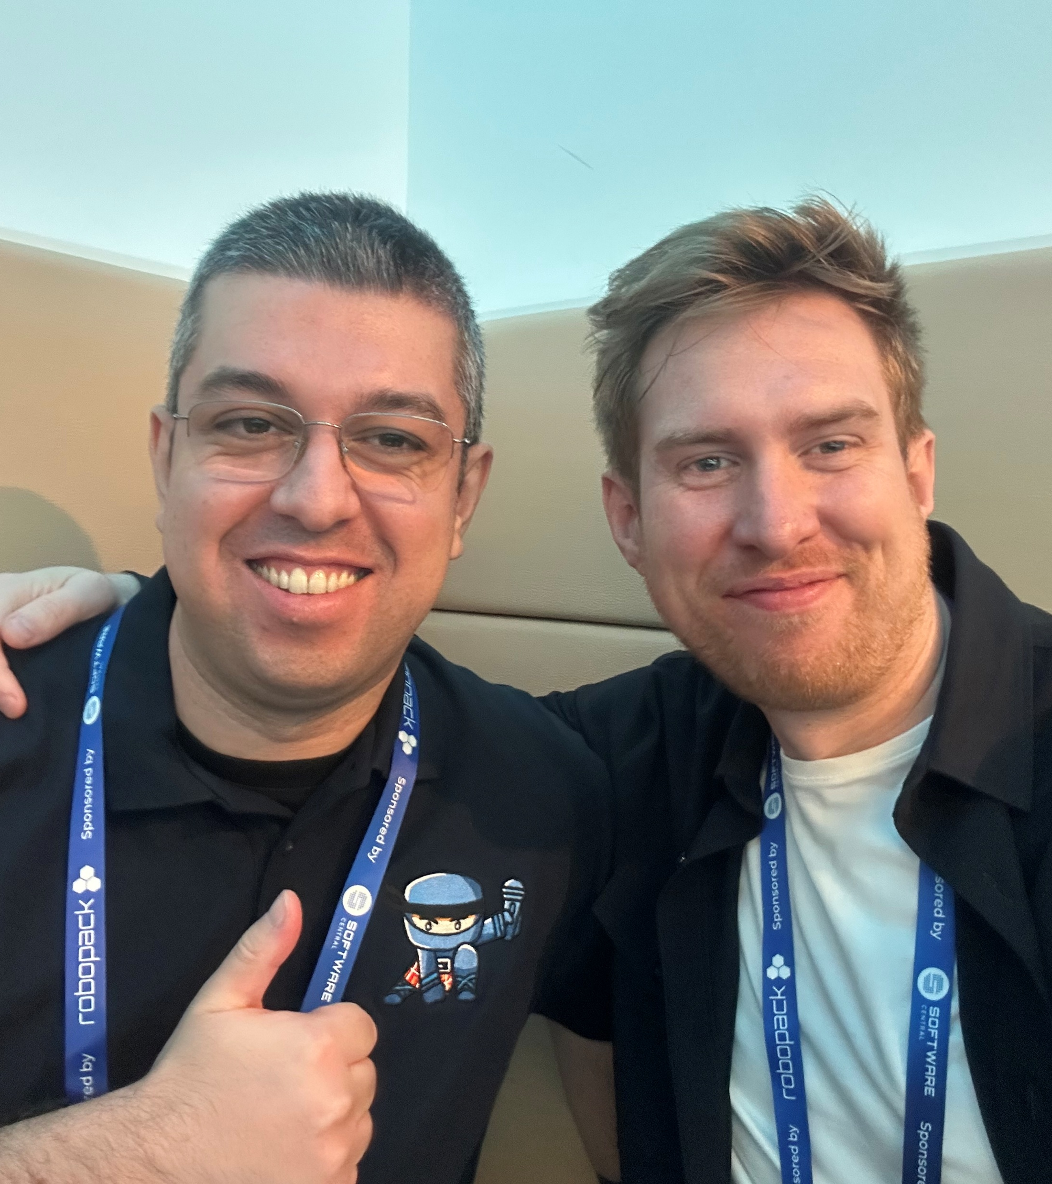
Co-host Ugur Koc
Community Microsoft MVP for Intune and Security Copilot Team Member of Workplace Ninja Germany
Creator of 🚀 Intune Brew Intune assignment checker Agents For Admins Intune RBAC Intune Monitoring Device Offboarding Manager KQLSearch
Workplace PM @ glueckkanja
Blog https://ugurkoc.de/
Linkedin https://www.linkedin.com/in/ugurkocde/
Latest hot news Just shipped by Ugur (https://www.linkedin.com/newsletters/7345954317935276033/)
Notes:
https://www.linkedin.com/newsletters/7345954317935276033/

Slide 5
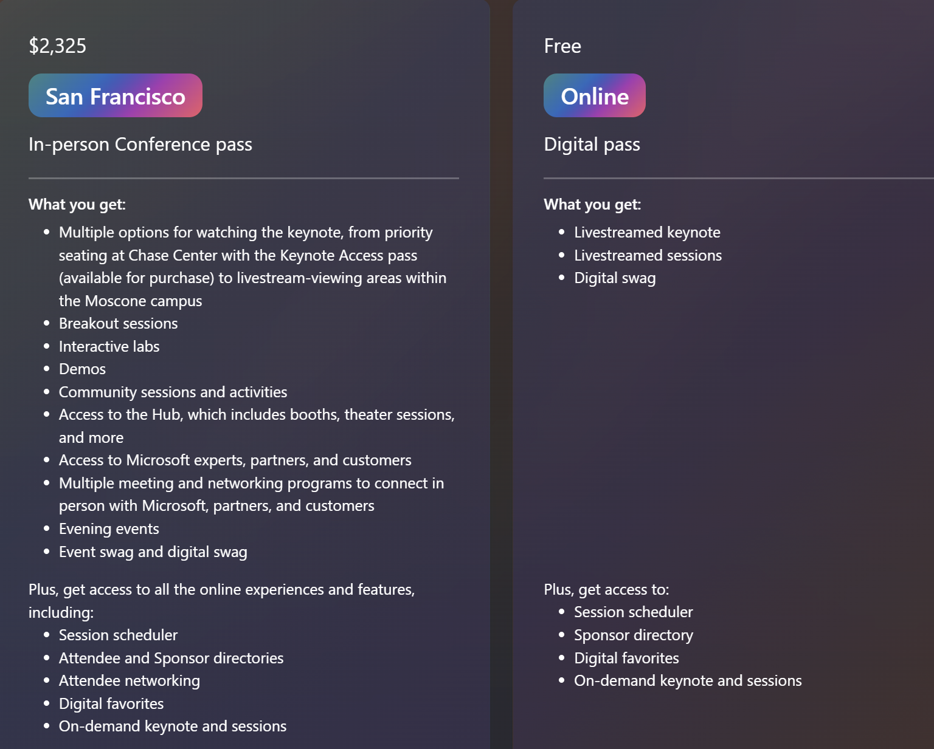
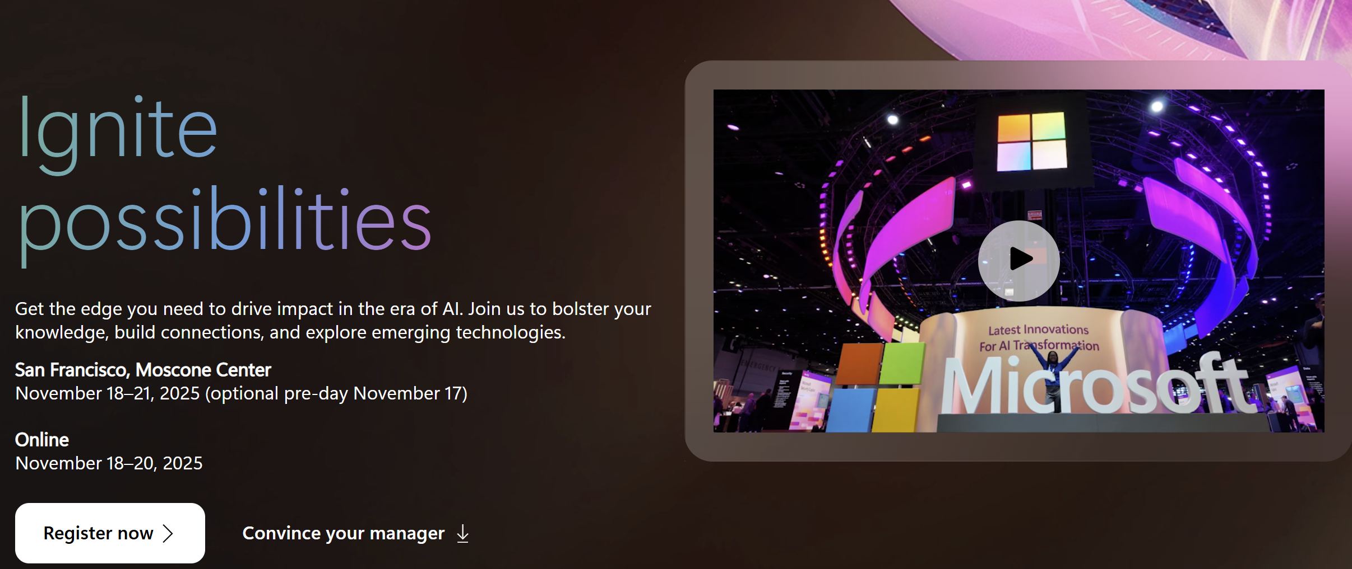
MS Ignite sign-up is open in total $ 3200 or 2.700 EUR (no dinner)
USA, San Francisco
November 18-21 (preday on 17th)
Ticket – ($2325)
Flight from DEN – SF ($790,64)
Hotel pr night $80 pr night (5 nights: $400)
Eat out everyday, every meal $150–$250
Notes:
https://ignite.microsoft.com/en-US/home

Slide 6
Links to share
MCP for Beginners
Configure Verified ID settings for an access package in entitlement management
Marcus Burnap - Microsoft Security - Sentinel - Defender XDR
Apple MDM Migration (next slide)
Convert Group Source of Authority to the cloud (next slide)
Five States of transformation (next slide)
Notes:
MCP for Beginners (talks about security and how to build your first MCP server)
https://www.youtube.com/playlist?list=PLlrxD0HtieHjYfVUpGl_-ai7D6FRBjV-d
Configure Verified ID settings for an access package in entitlement management
https://learn.microsoft.com/en-us/entra/id-governance/entitlement-management-verified-id-settings
Marcus Burnap - Microsoft Security - Sentinel - Defender XDR
https://mbcloudteck.substack.com/p/navigating-the-future-with-Microsoft

Slide 7
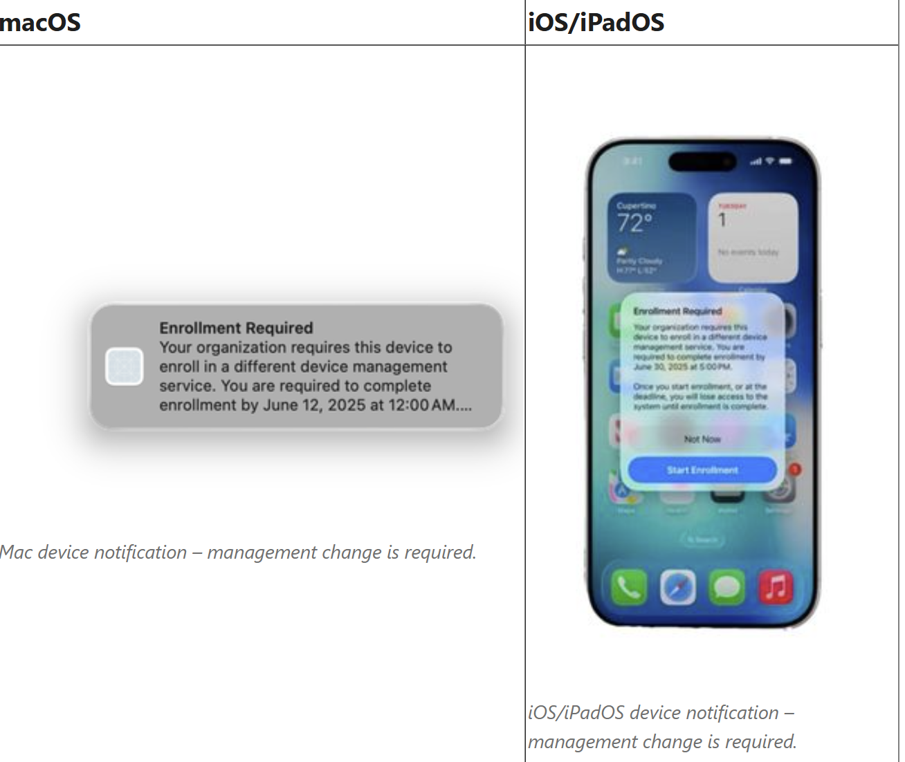
Apple MDM Migration
Seamlessly migrate devices to Intune without wiping or re-enrolling.
Assign Intune as the new MDM directly in ABM/ASM.
Users get a prompt and migrate without reboots or data loss.
Rebuild existing MDM configs in Intune before the switch.
Requires Apple OS 26 and integration with ABM/ASM.
Notes:
https://techcommunity.microsoft.com/blog/intunecustomersuccess/apple-making-device-migration-to-microsoft-intune-easy-with-upcoming-os-26-relea/4439895

Slide 8
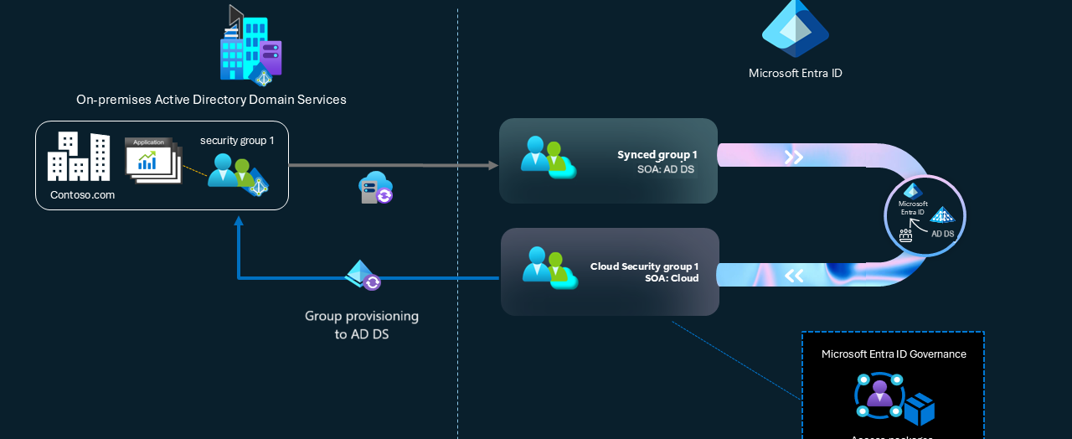
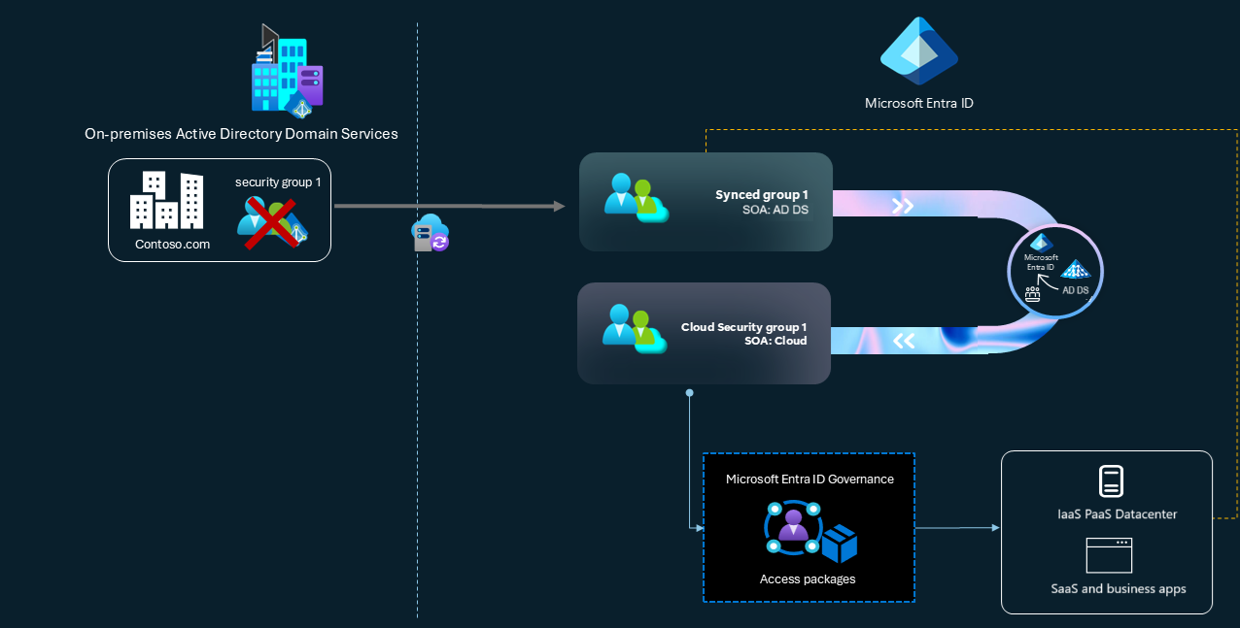
Convert Group Source of Authority to Entra ID
Govern access with Microsoft Entra ID Governance
Control legacy app access using cloud-managed group memberships.
Apps use Kerberos or LDAP to read group info.
Convert AD DS group Source of Authority (SOA) to Microsoft Entra ID to manage group membership directly in the cloud
Adopt a cloud-first identity model to minimize reliance on AD DS and shrink your on-premises footprint.
Use object-level SOA to gradually move specific groups to the cloud without disrupting end users.
Use Microsoft Entra ID Governance to manage access for both cloud and legacy on-premises apps.
Convert on-premises DLs and mail-enabled groups to cloud-managed groups for full management in Exchange Online.
Aligns with the Five states of transformation ->
AD DS Minimization
Retire AD groups. Manage access entirely in the cloud.
Apps now use SAML or OpenID Connect via Entra ID.
Notes:
https://learn.microsoft.com/en-us/entra/identity/hybrid/concept-source-of-authority-overview
https://learn.microsoft.com/en-us/entra/architecture/road-to-the-cloud-posture#five-states-of-transformation

Slide 9
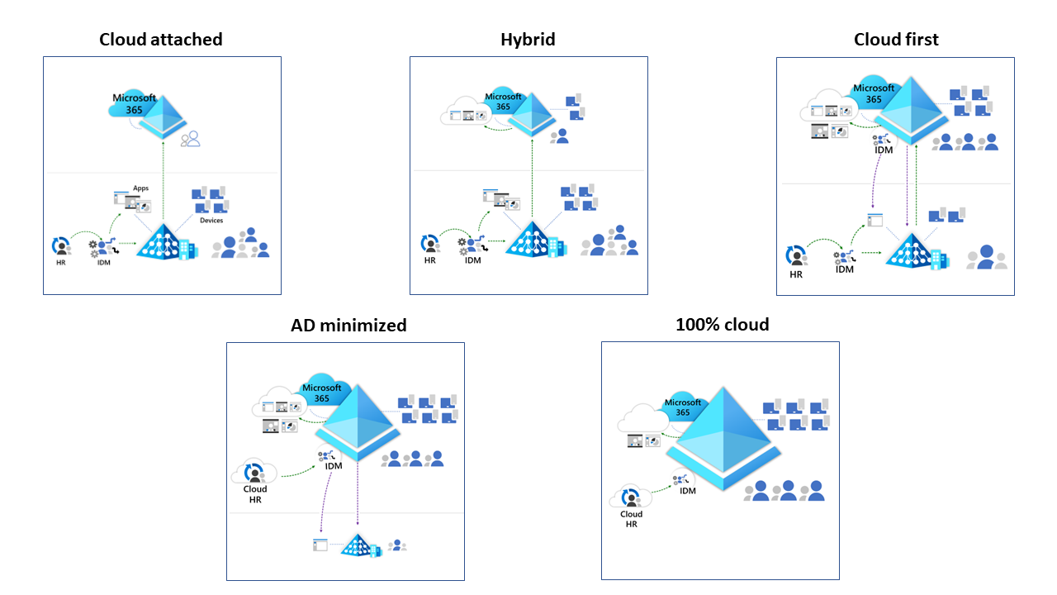
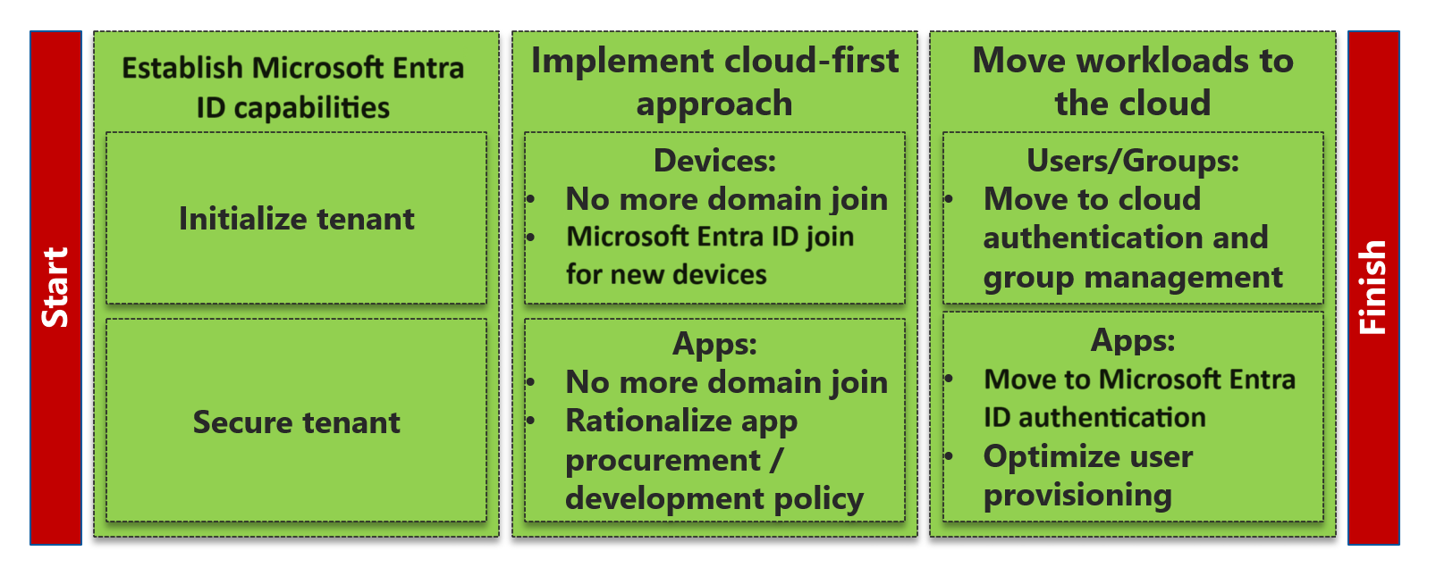
Five states of transformation
In enterprise-sized organizations, IAM transformation, or even transformation from Active Directory to Microsoft Entra ID, is typically a multi-year effort with multiple states
Notes:
https://learn.microsoft.com/en-us/entra/architecture/road-to-the-cloud-posture#five-states-of-transformation

Slide 10
What state do you see the most?
1. Cloud Attached
(Basic Entra ID use. Identity still managed on-prem)
2. Hybrid
(Cloud features added. IAM split between AD and Entra ID)
3. Cloud First
(New workloads go cloud. AD dependency begins shrinking)
4. Active Directory Minimized
(Most identity in Entra ID. AD used for exceptions only)
5. 100% Cloud
(Full cloud identity. No on-prem IAM left)
Notes:
https://learn.microsoft.com/en-us/entra/architecture/road-to-the-cloud-posture#five-states-of-transformation

Slide 11
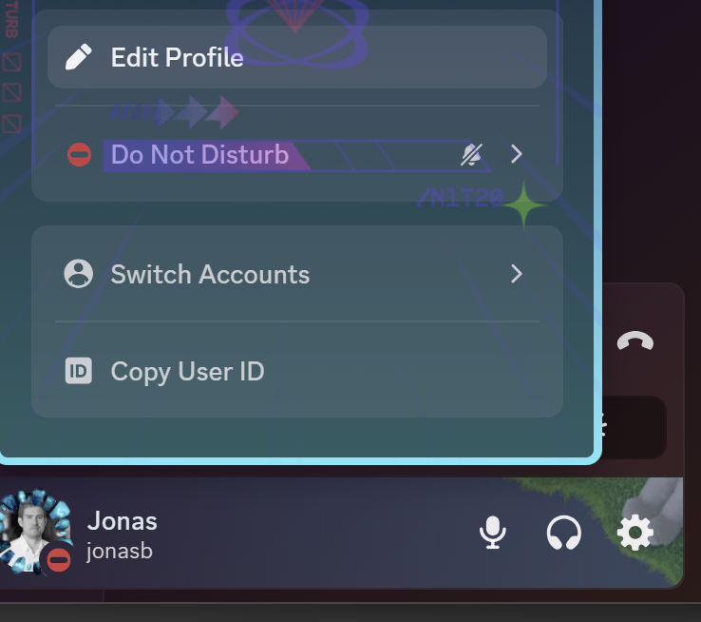


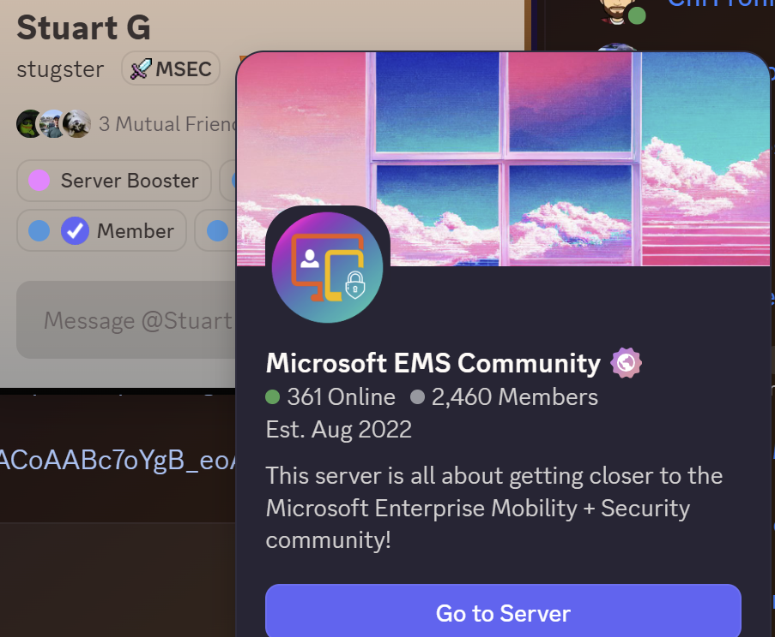
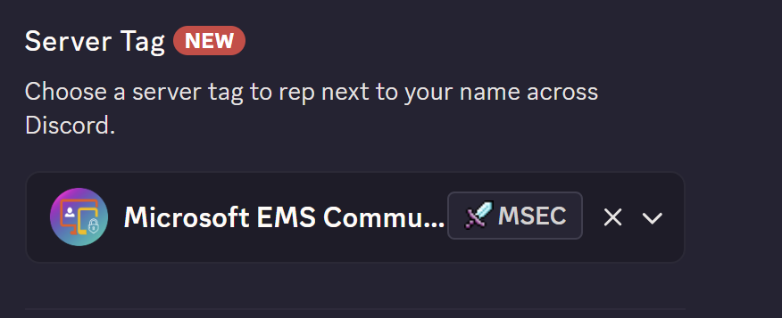
Discord Server tag
1
2

Slide 12
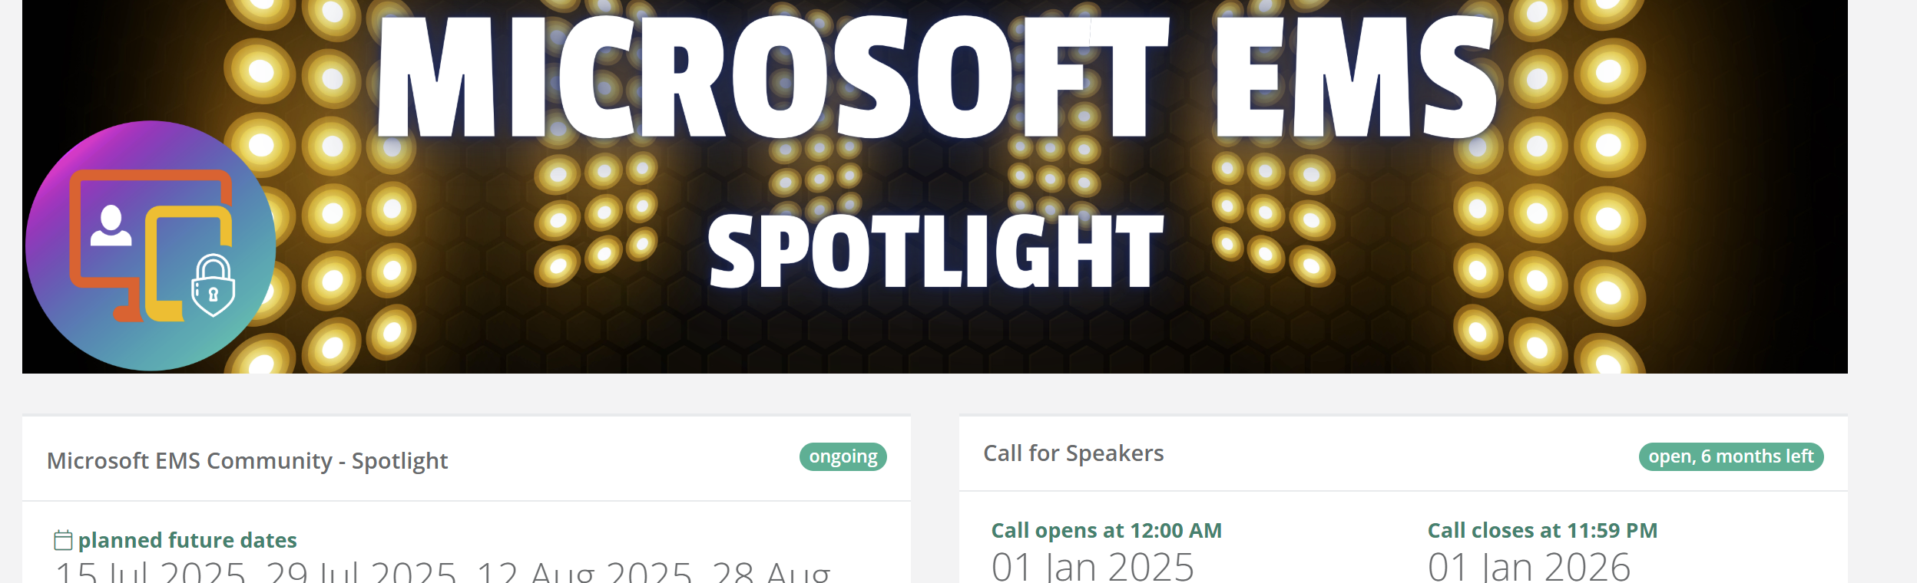
Want to a join Spotlight?
Do you have tools, ideas, or projects you’re passionate about?
Showcase your work
Refine your material and receive valuable feedback.
Expand your network and build visibility.
Sessions are typically 1 hour.
20-50 views
https://sessionize.com/microsoft-ems-community-spotlight/

Slide 13
Agenda
macOS LAPS
State of Agents
Community Tools
Open floor

Slide 14
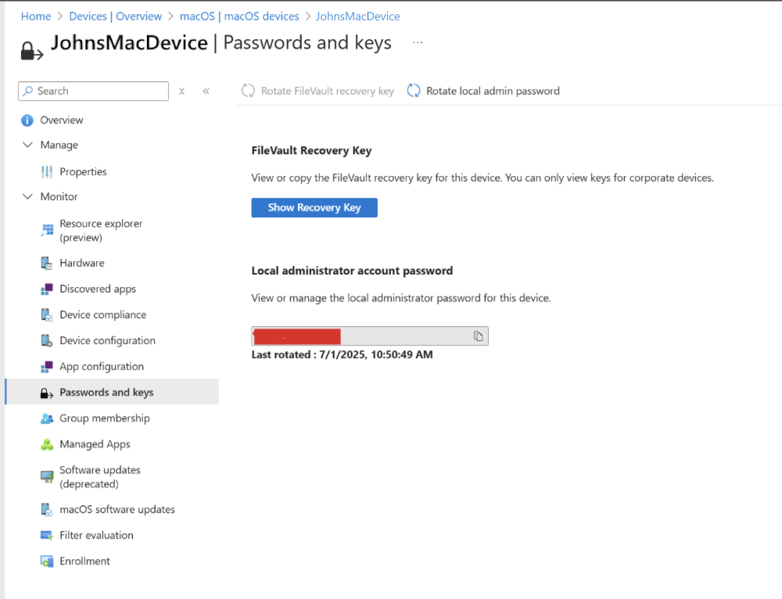
macOS LAPS
Configure both accounts at enrollment with randomized, encrypted admin passwords.
Passwords rotate every 6 months or on-demand through device actions.
Custom Intune roles needed to view or rotate macOS admin passwords.
Re-enrollment is required to apply LAPS to previously enrolled devices.
Admin account lacks secure token: user account gets it on first login.
Notes:
https://learn.microsoft.com/en-us/intune/intune-service/enrollment/macos-laps

Slide 15
State of Agents (Security Copilot)
Intune
Intune Explorer
Entra
Conditional Access Analyzer
Security Copilot
KQL Queries Made Easy: My Intune Admin Journey with Copilot
Notes:
https://ugurkoc.de/kql-queries-made-easy-my-intune-admin-journey-with-copilot/

Slide 16
Community Tools
MDEAutomator
PurpleRepo
TenuVault Intune Backup & Recovery
Talk about Community tools in general with Ugur
Notes:
https://github.com/msdirtbag/MDEAutomator
https://hunt.quasarops.com/
https://www.tenuvault.com/coming-soon

Slide 17
Openfloor

Slide 18
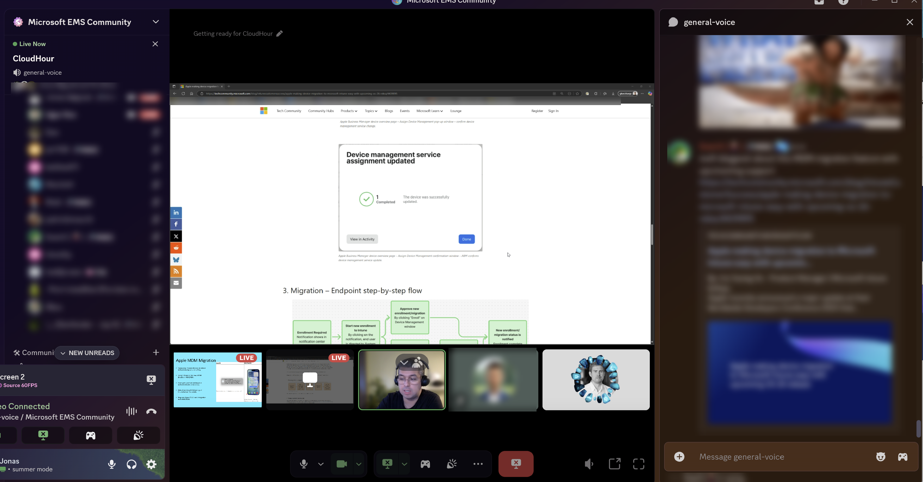
Screenshot from the CloudHour

Slide 19
Consider joining us! 😊
Join link: https://discord.com/invite/9eujqRT3AB

